Slide 1
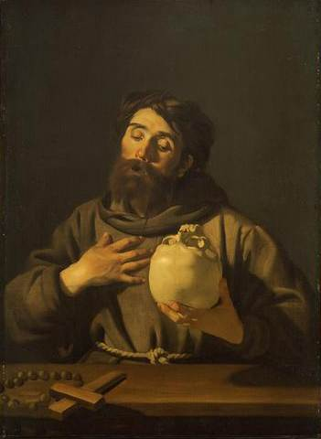


Slide 2
Dirck Jaspersz. van Baburen
(1595–1624)
Dutch painter
associated with the Utrecht Caravaggisti

Slide 3
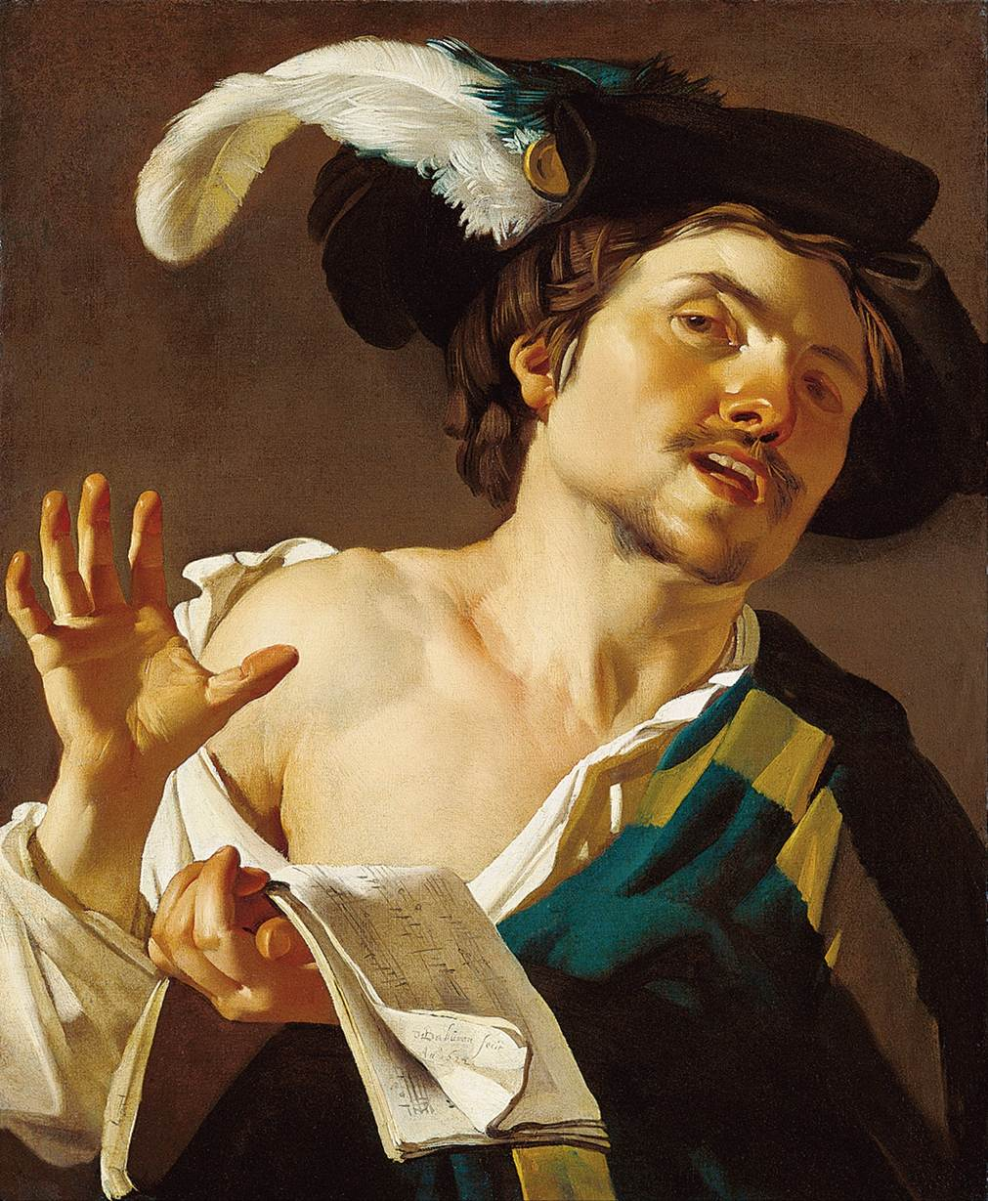
Notes:
Young Man Singing

Slide 4
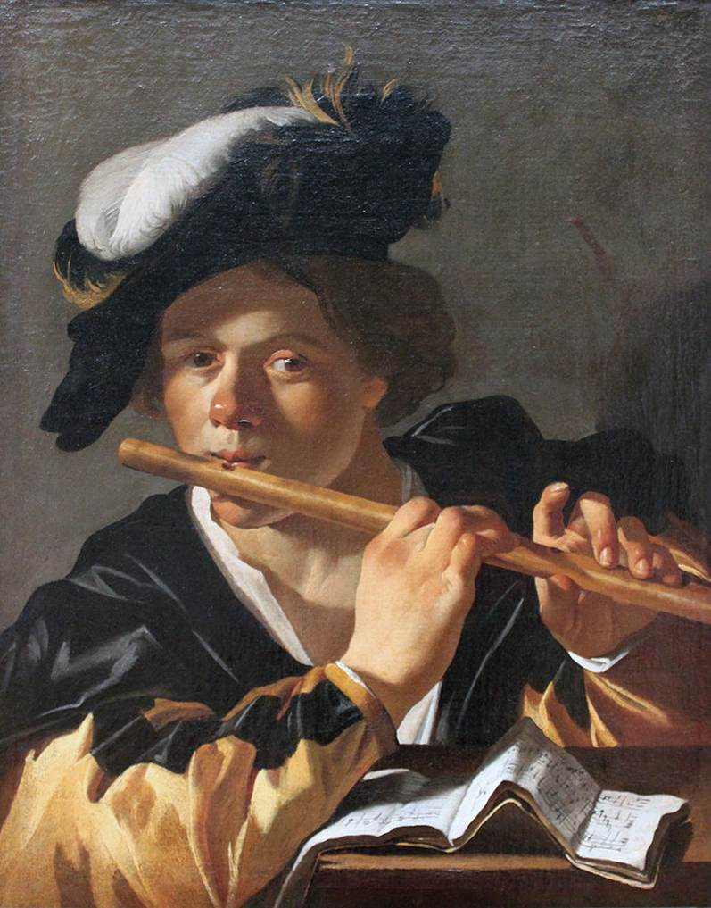
Notes:
The Flute Player

Slide 5
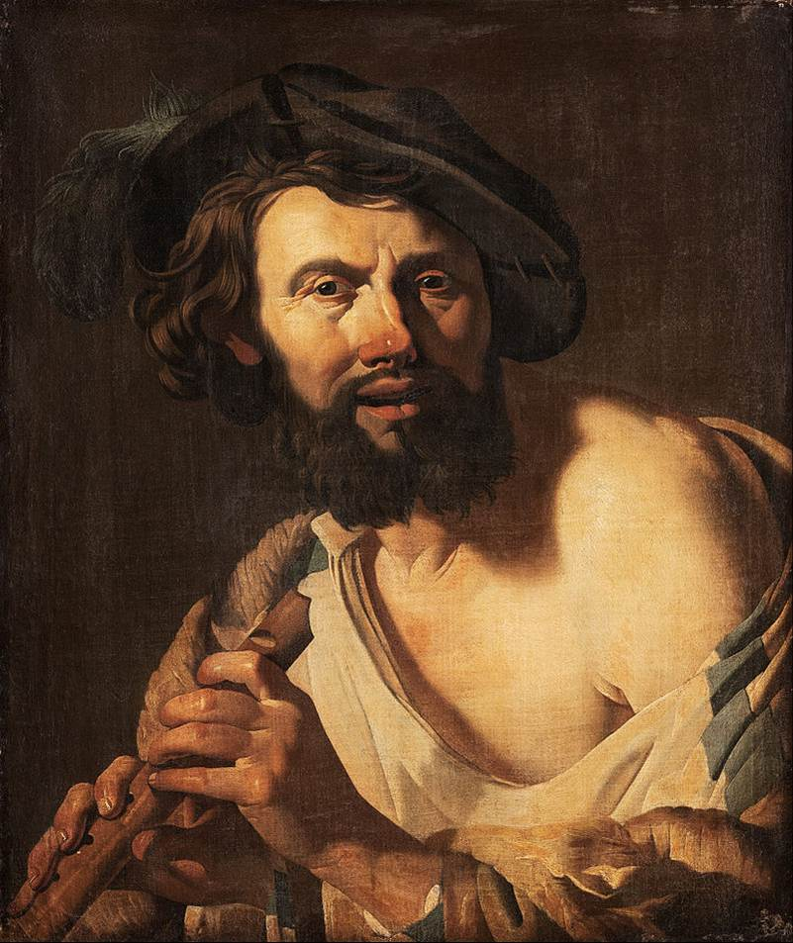
Notes:
Man with a flute

Slide 6
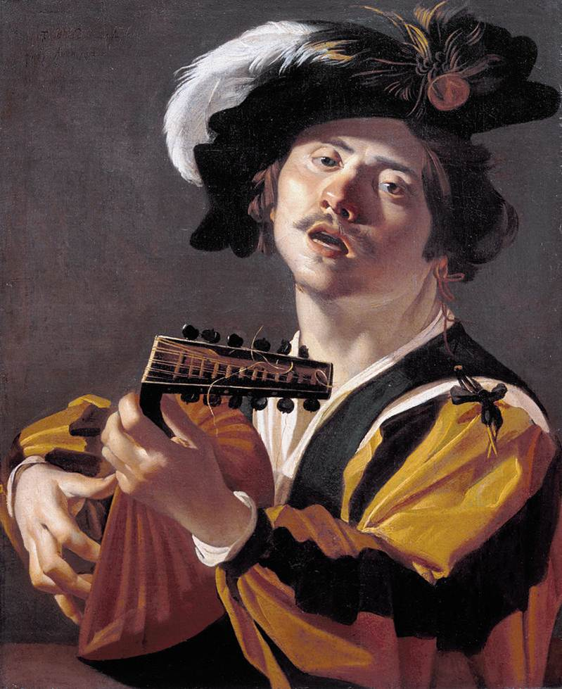
Notes:
The Lute Player

Slide 7
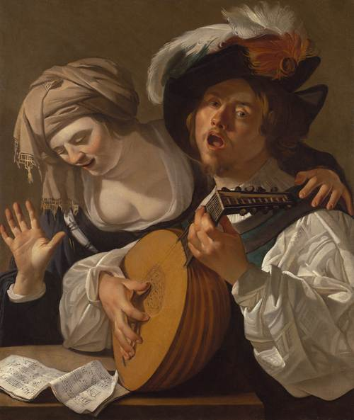

Slide 8
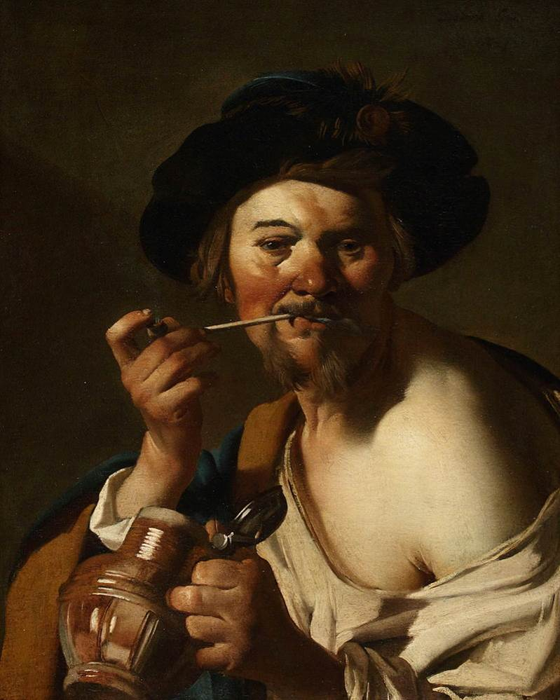

Slide 9
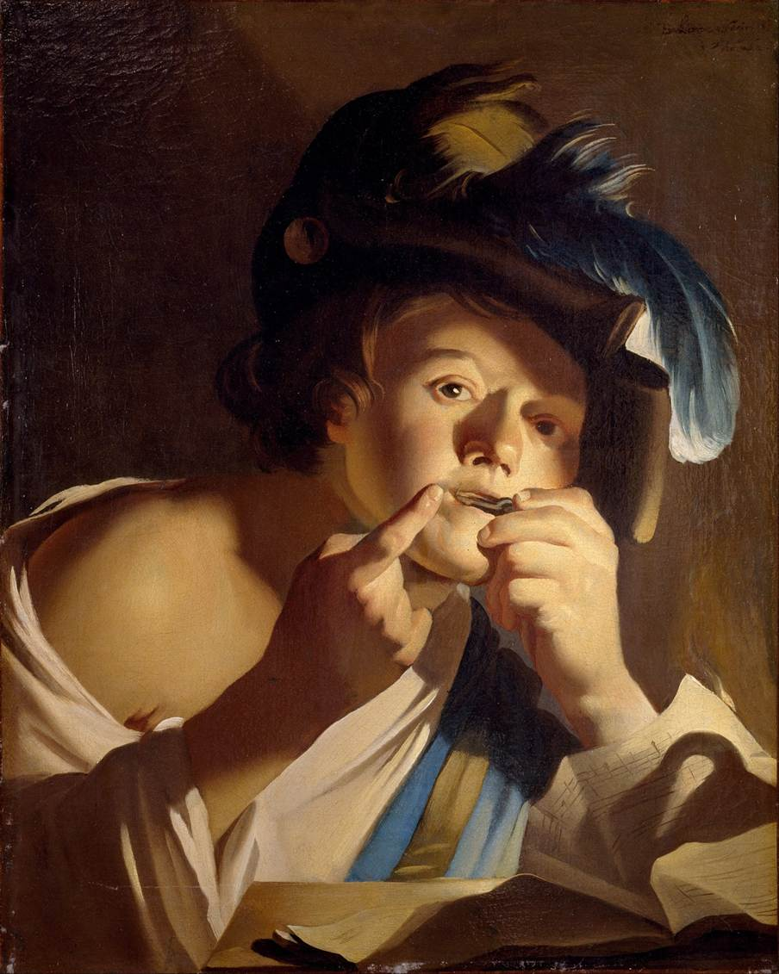
Notes:
Young man with jew's harp

Slide 10
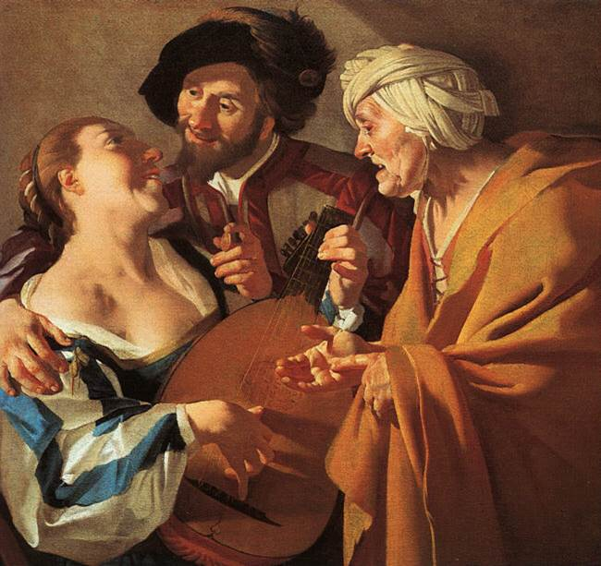
Notes:
The Procuress

Slide 11
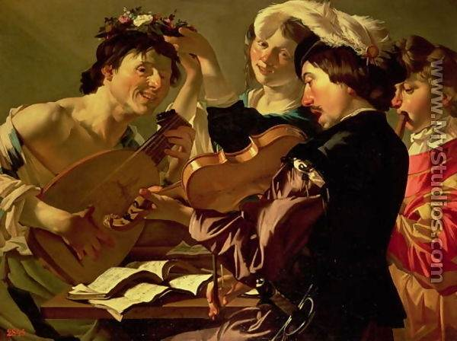

Slide 12
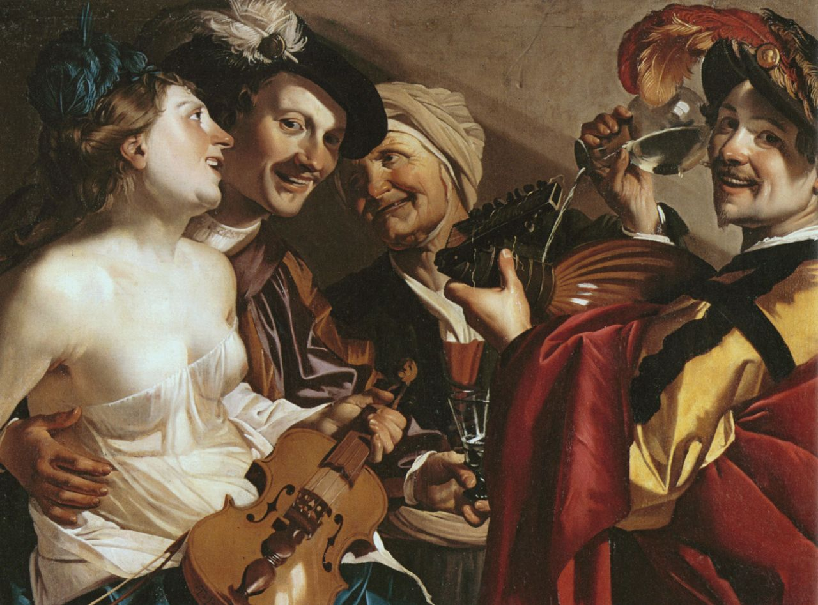

Slide 13
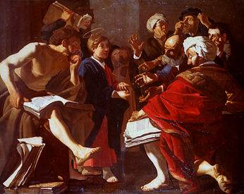
The Young Jesus among the Doctors(눅2:46)
Notes:
: Jesus among the Doctors

Slide 14
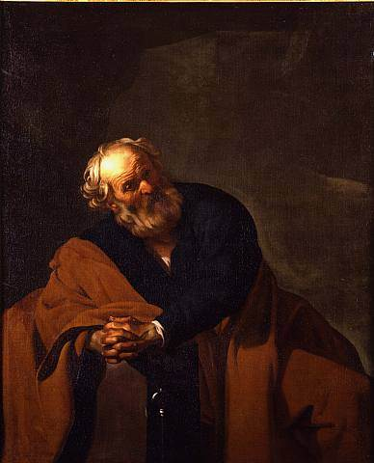
Saint Peter

Slide 15
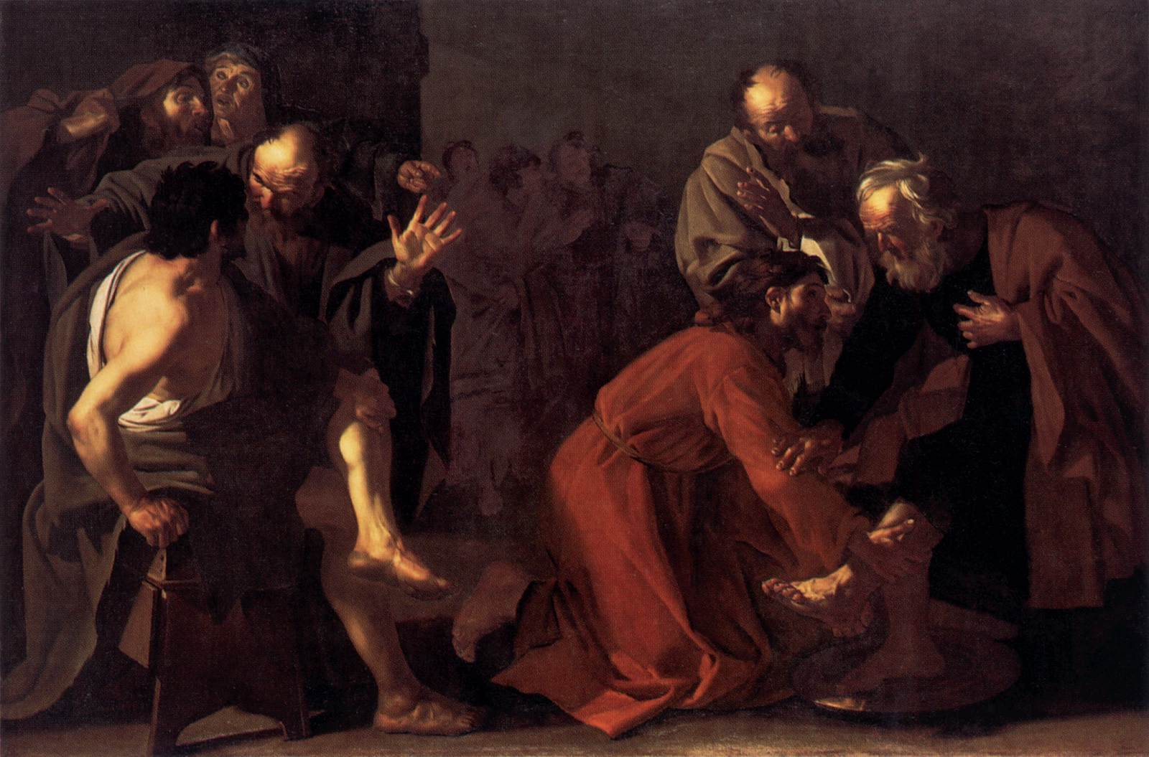
Christ Washing the Apostles Feet(요13:12)

Slide 16
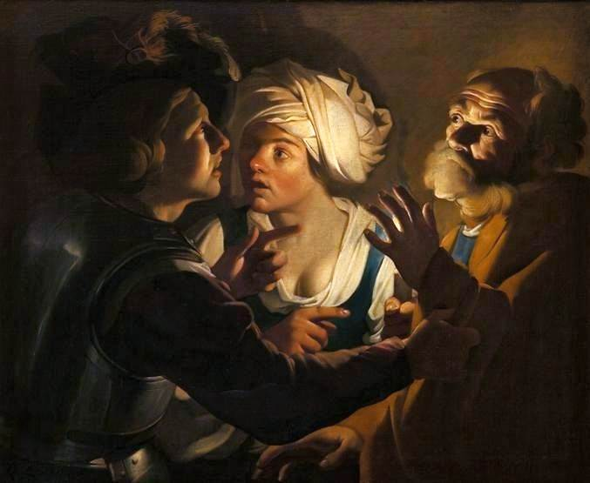
Denial of Saint Peter(마26:69)

Slide 17
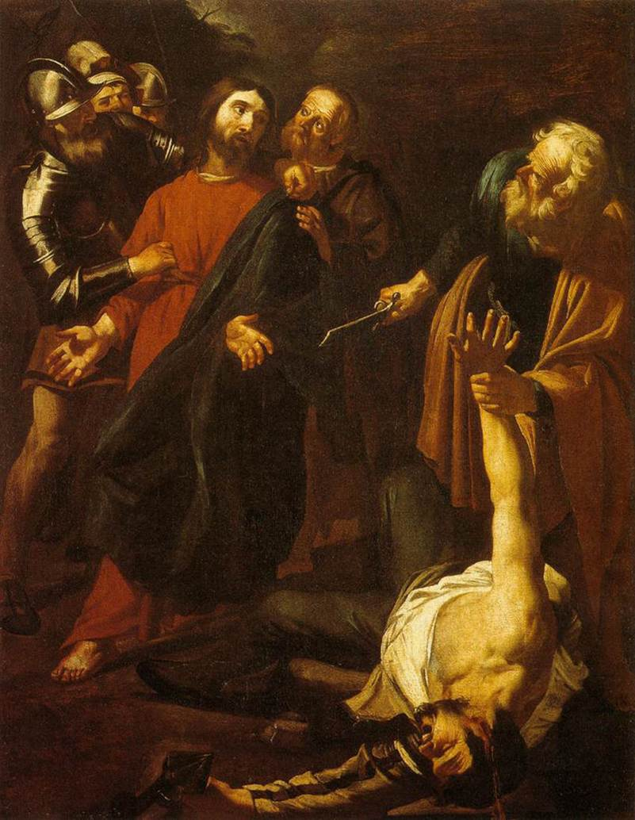
The Capture of Christ with the Malchus Episod
Notes:
e

Slide 18
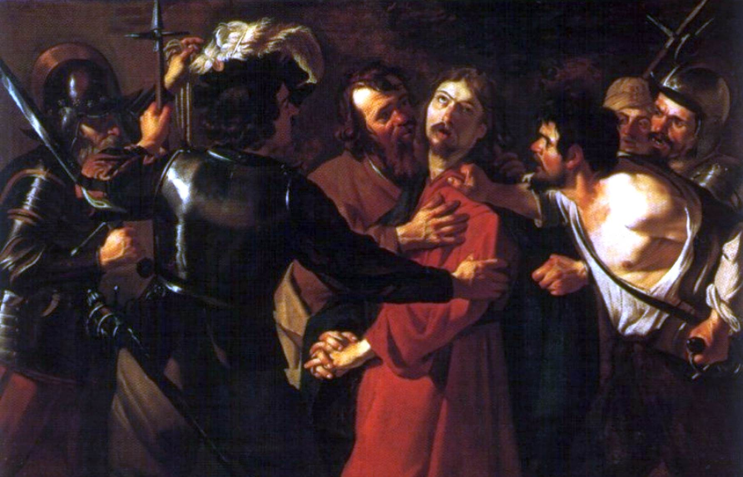
Jesus Captured(마26:48)
Notes:
Jesus Captured

Slide 19
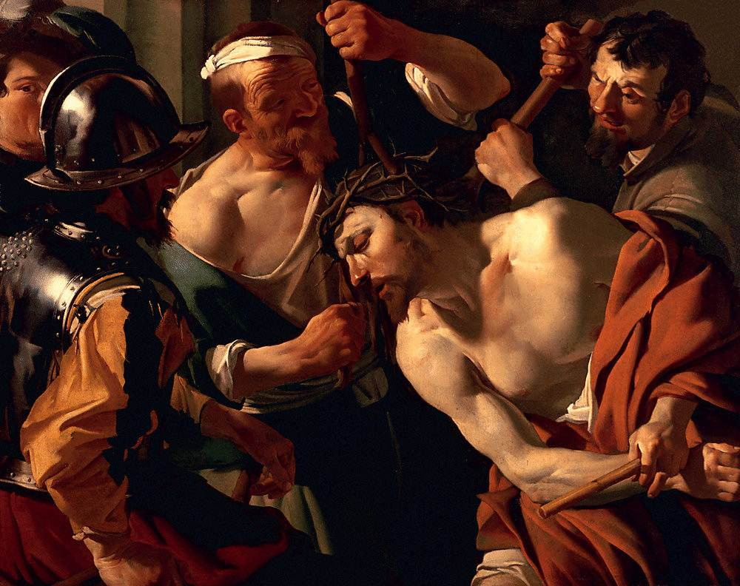
The Crowning with Thorns(막15:17)
Notes:
The Crowning with Thorns

Slide 20
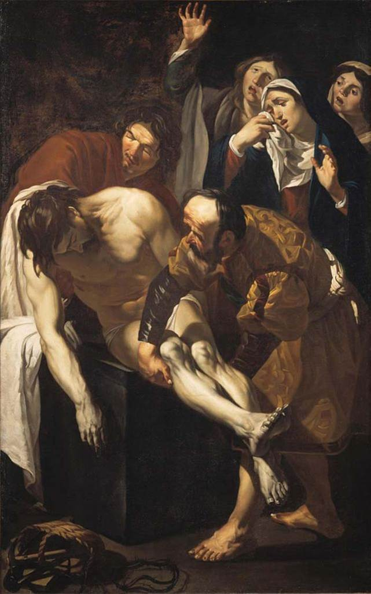
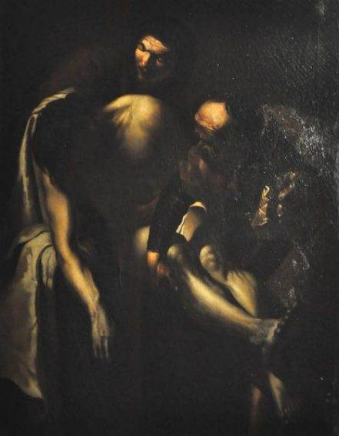
The Deposition(요19:38)
END

